Slide 1
Lecture-7
Pointers

Slide 2
We’ll Learn Today
Introduction
Pointer Variable Definition & Initialization
Pointer Operators
Calling Function by Reference
Using const Qualifier in Pointers
Pointers & Arrays
Pointers & 2-Dimentional Arrays
Excercise

Slide 3
Introduction
Pointer are a fundamental part of C. If you cannot use pointers properly then you have basically lost all the power and flexibility that C allows. The secret to C is in its use of pointers.
C uses pointers a lot. Why?:
  pass-by-reference,
  to pass functions between functions, and
  to create and manipulate dynamic data structures,
  It is the only way to express some computations.
  It produces compact and efficient code.
  It provides a very powerful tool.
C uses pointers explicitly with:
  Arrays,
  Structures,
  Functions.
NOTE: Pointers are perhaps the most difficult part of C to understand. C's implementation is slightly different DIFFERENT from other languages.

Slide 4
Pointer Variable Definitions and Initialization
Pointer variables
  Contain memory addresses as their values
  Normal variables contain a specific value (direct reference)
  Pointers contain address of a variable that has a specific value (indirect reference)
  Indirection – referencing a pointer value
count
7
countPtr
count
7

Slide 5
Pointer Variable Definitions and Initialization
Pointer definitions
  * used with pointer variables
      int *myPtr;
  Defines a pointer to an int (pointer of type int *)
  Multiple pointers require using a * before each variable definition
      int *myPtr1, *myPtr2;
  Can define pointers to any data type
  Initialize pointers to 0, NULL, or an address
    0 or NULL – points to nothing (NULL preferred)

Slide 6
Pointer Operators
& (address operator)
  Returns address of operand
    int y = 5;
    int *yPtr;
    yPtr = &y; /* yPtr gets address of y */
    yPtr “points to” y
y
yptr
y
yPtr
5
500000
600000
600000
5
Address of y is value of yptr

Slide 7
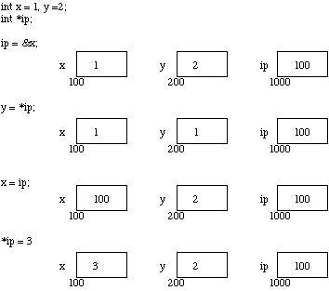
Important Concepts

Slide 8
Important Concepts(cont’d)
IMPORTANT:
When a pointer is declared it does not point anywhere. You must set it to point somewhere before you use it.
So ...
int *ip;
*ip = 100;
will generate an error (program crash!!).
The correct use is:
int *ip;
int x;
ip = &x;
*ip = 100;

Slide 9
Important Concepts(cont’d)
We can do integer arithmetic on a pointer:
float *flp, *flq;
*flp = *flp + 10;
++*flp;
(*flp)++;
flq = flp;
NOTE:
A pointer to any variable type is an address in memory -- which is an integer address. A pointer is definitely NOT an integer.

Slide 10

Important Concepts(cont’d)
The reason we associate a pointer to a data type is so that it can show many bytes the data is stored in. When we increment a pointer we increase the pointer by one ``block'' memory.
So for a character pointer ++ch_ptr adds 1 byte to the address.
For an integer or float ++ip or ++flp adds 4 bytes to the address.
Consider a float variable (fl) and a pointer to a float (flp) as shown in Fig. below.
Above Fig. Pointer Arithmetic Assume that flp points to fl then if we increment the pointer ( ++flp) it moves to the position shown 4 bytes on. If on the other hand we added 2 to the pointer then it moves 2 float positions i.e 8 bytes as shown in the Figure.

Slide 11
Simple Example
void main(void)
{
int a,b;
int *pa, *pb;
a=5; b=10;
pa=&a; pb=&b;
*pa = *pa +10;
*pb = *pb +10;
printf(“ %d “, a);
printf(“\n %d “,b);
}

Slide 12
Another Example
void main(void)
{
int I, *p1, **p2;
i=5;
p1 = &I;
p2 = &p1;
pirntf(“ %d “, **p2 );
printf(“ %d “, * p1);
}
What will be the output??????

Slide 13
Calling Functions by Reference
Call by reference with pointer arguments
  Pass address of argument using & operator
  Allows you to change actual location in memory
  Arrays are not passed with & because the array name is already a pointer
* operator
  Used as alias/nickname for variable inside of function
      void double( int *number )
      {
      *number = 2 * ( *number );
      }
  *number used as nickname for the variable passed

Slide 14
Conceptual Example
(Call-by-Value)
int
main()
number
int
cubeByValue(
int
n )
{
{
int
number =
5
;
5
return
n * n * n;
}
n
number=cubeByValue(number);
}
undefined
After
cubeByValue
receives the call:
int
main()
number
int
cubeByValue(
int
n )
{
{
int
number =
5
;
5
return
n * n * n;
}
number = cubeByValue( number );
n
}
5
After
cubeByValue
cubes parameter
n
and before
cubeByValue
returns to
main
:
int
main()
number
int
cubeByValue(
int
n )
{
{
125
int
number =
5
;
5
return
n * n * n;
}
number = cubeByValue( number );
n
}
5

Slide 15
Conceptual Example
(Call-by-Value)
After
cubeByValue
returns to
main
and before assigning the result to
number
:
int
main()
number
int
cubeByValue(
int
n )
{
{
int
number =
5
;
5
return
n * n * n;
125
}
number = cubeByValue( number );
n
}
undefined
After
main
completes the assignment to
number
:
int
main()
number
int
cubeByValue(
int
n )
{
{
int
number =
5
;
125
return
n * n * n;
125
125
}
number = cubeByValue( number );
n
}
undefined

Slide 16
Conceptual Example
(Call-by-Reference)
Before
main
calls
cubeByReference
:
int
main()
number
void
cubeByReference(
int
*nPtr )
{
5
{
int
number =
5
;
*nPtr = *nPtr * *nPtr * *nPtr;
}
cubeByReference( &number );
nPtr
}
undefined
After
cubeByReference
receives the call and before
*nPtr
is cubed:
int
main()
number
void
cubeByReference(
int
*nPtr )
{
5
{
int
number =
5
;
*nPtr = *nPtr * *nPtr * *nPtr;
}
cubeByReference( &number );
nPtr
}
call establishes this pointer
After
*nPtr
is cubed and before program control returns to
main
:
int
main()
number
void
cubeByReference(
int
*nPtr )
{
125
{
125
int
number =
5
;
*nPtr = *nPtr * *nPtr * *nPtr;
}
cubeByReference( &number );
called function modifies
nPtr
}
caller’s variable

Slide 17
Using the const Qualifier with Pointers
const qualifier
  Variable cannot be changed
  Use const if function does not need to change a variable
  Attempting to change a const variable produces an error
const pointers
  Point to a constant memory location
  Must be initialized when defined
  int *const myPtr = &x;
    Type int *const – constant pointer to an int
  const int *myPtr = &x;
    Regular pointer to a const int
  const int *const Ptr = &x;
    const pointer to a const int
    x can be changed, but not *Ptr

Slide 18
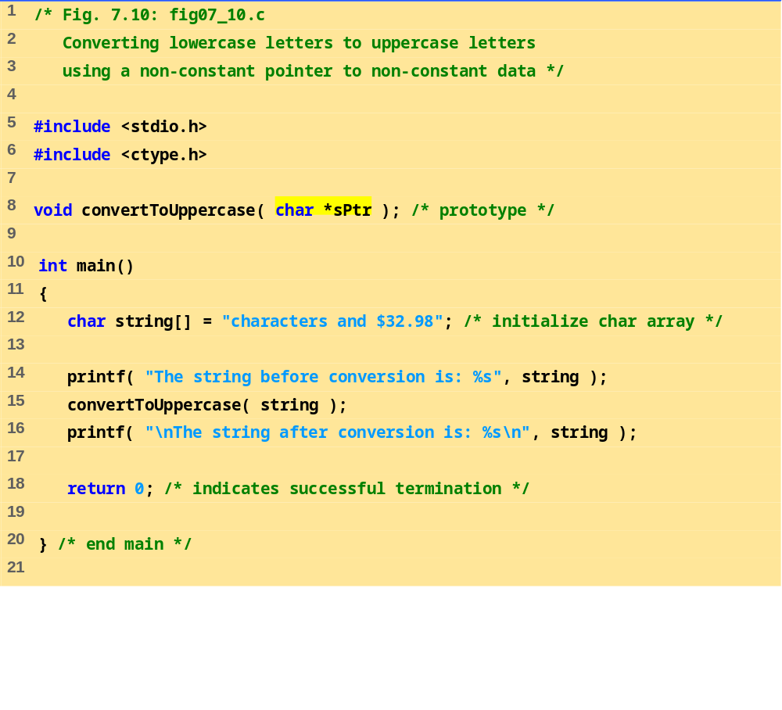

Slide 19
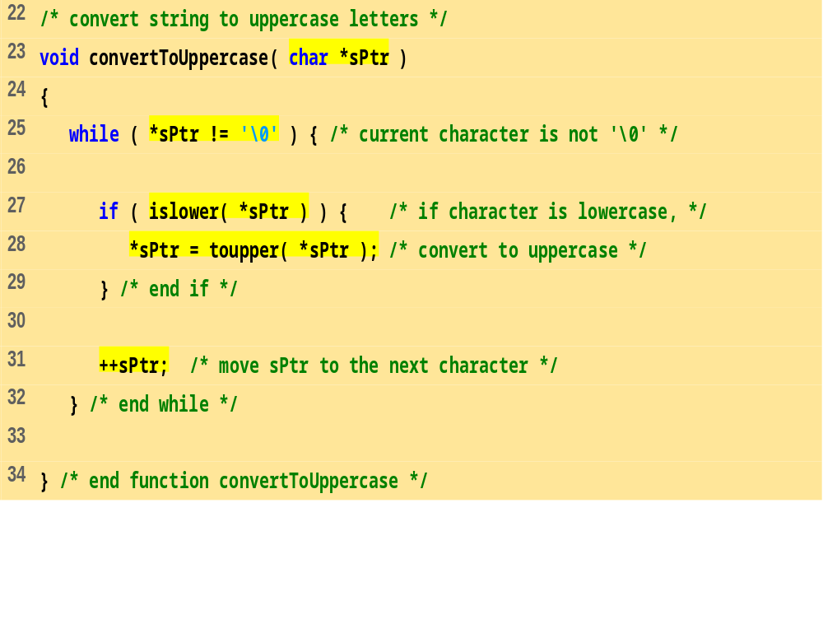
The string before conversion is: characters and $32.98
The string after conversion is: CHARACTERS AND $32.98

Slide 20
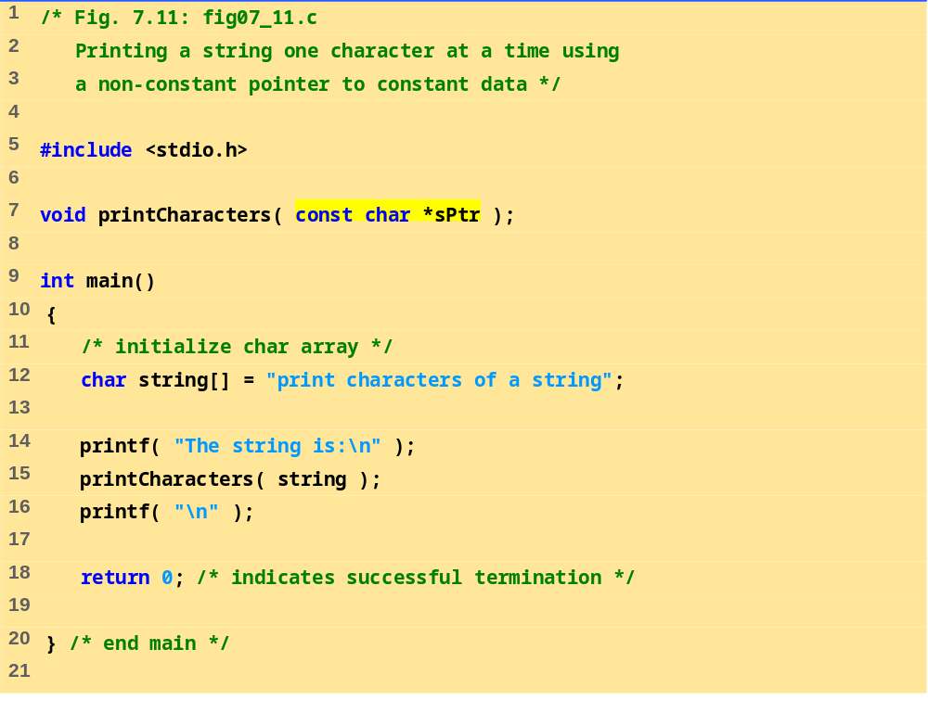

Slide 21
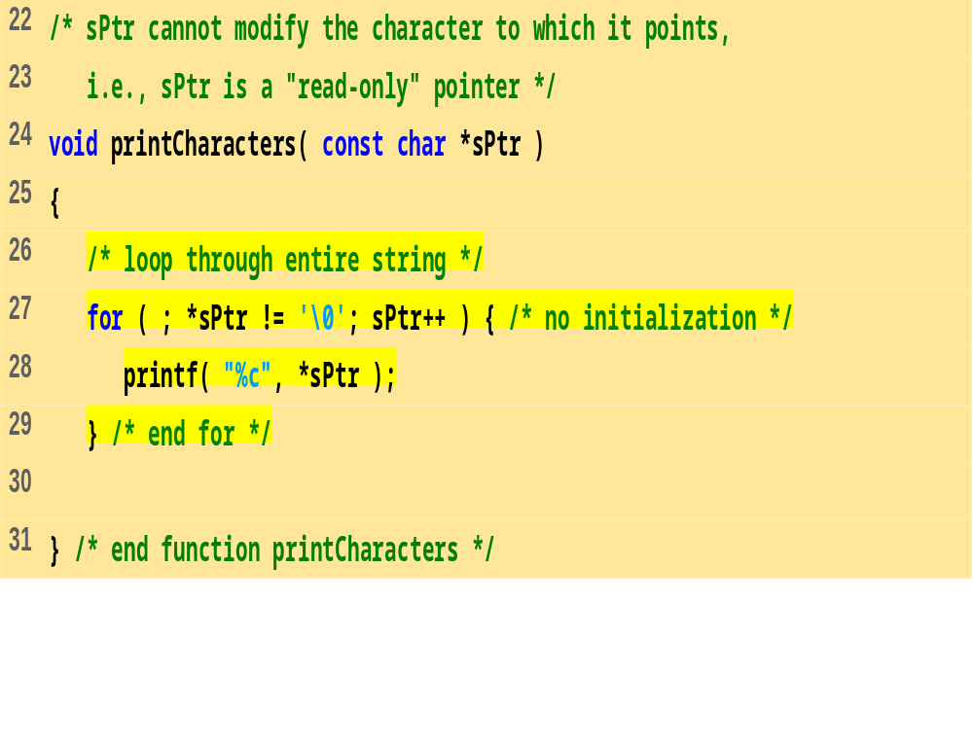
The string is:
print characters of a string

Slide 22
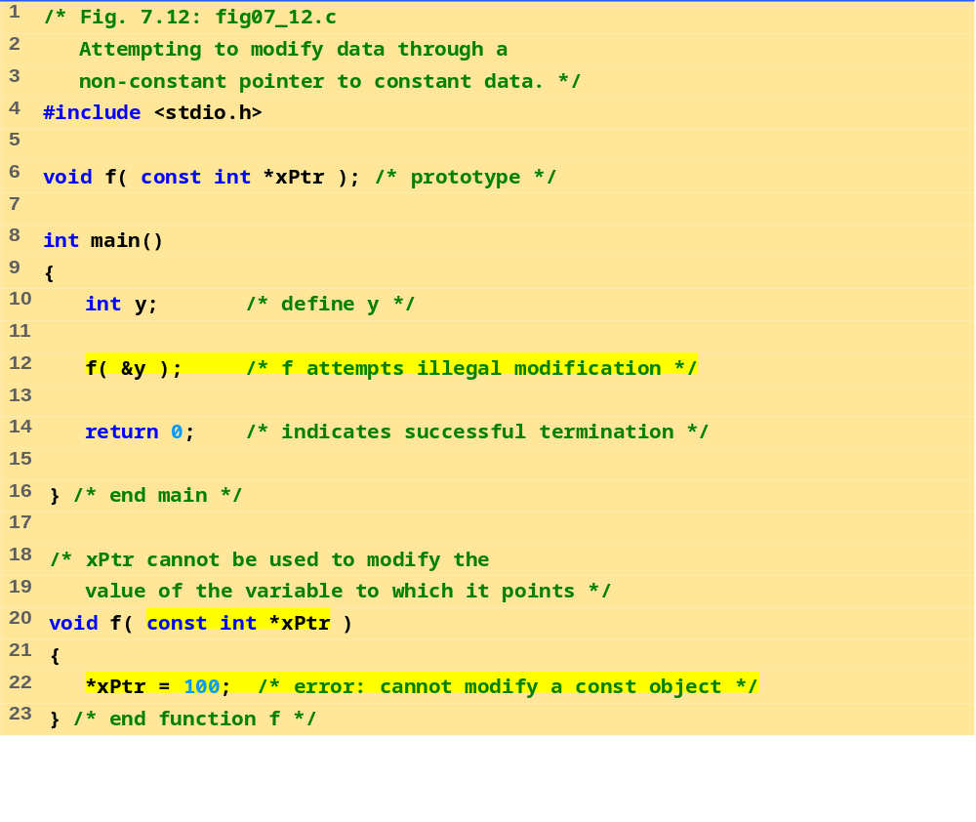

Slide 23
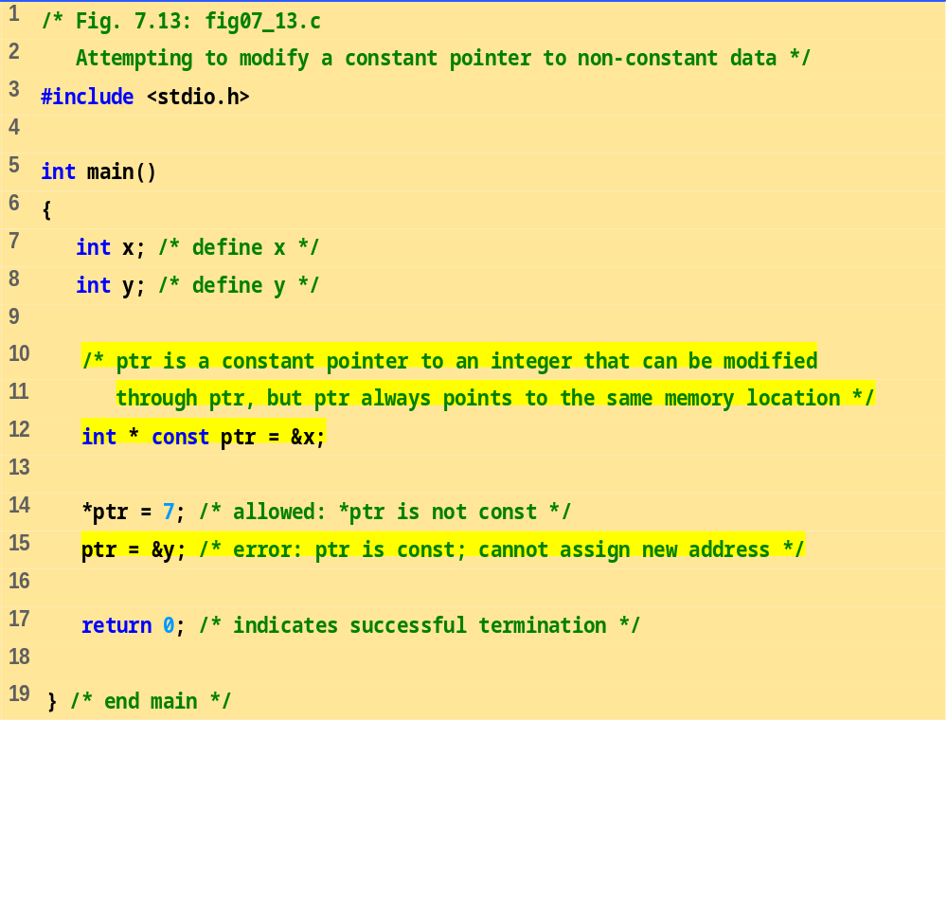
Changing *ptr is allowed – x is not a constant.
Changing ptr is an error – ptr is a constant pointer.

Slide 24
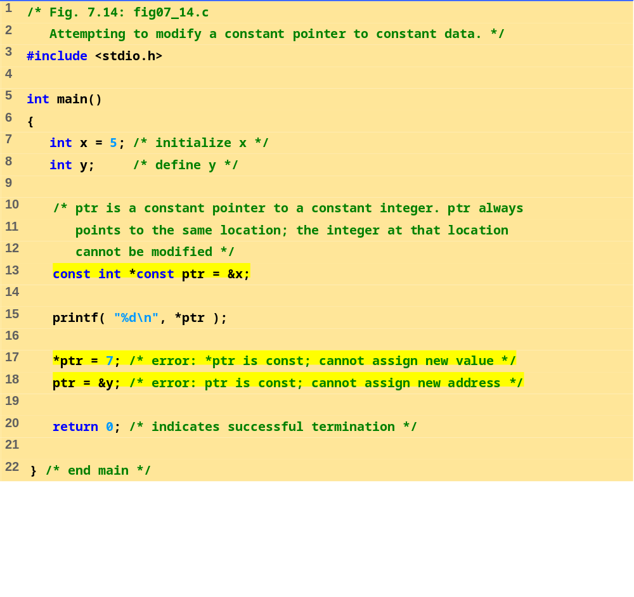
%

Slide 25

Pointers and Arrays
Pointers and arrays are very closely linked in C.
Consider the following:
int a[10], x;
int *pa;
pa = &a[0]; /* pa pointer to address of a[0] */
x = *pa;
/* x = contents of pa (a[0] in this case) */
To get somewhere in the array Fig. using a pointer we could do:
pa + i / a[i]
WARNING:
There is no bound checking of arrays and pointers so you can easily go beyond array memory and overwrite other things.

Slide 26
Pointers and Arrays(cont’d)
C however is much more subtle in its link between arrays and pointers.
For example we can just type
pa = a;
instead of
pa = &a[0]
and
a[i] can be written as *(a + i).
i.e. &a[i] a + i.
We can also express pointer addressing like this:
pa[i] = *(pa + i).

Slide 27
Differences between Pointers & Array
A pointer is a variable. We can do
pa = a and pa++.
An Array is not a variable. a = pa and a++ ARE ILLEGAL.
This stuff is very important. Make sure you understand it. We will see a lot more of this.

Slide 28
Simple Example
void main(void)
{
int num[5]={1,2,3,4,5};
int i, *ptr;
ptr = num;
for( i = 0; i<5; i++)
printf(“ %d “, *(ptr++));
}

Slide 29
Arrays of Pointers
We can have arrays of pointers since pointers are variables.
Example use:
Sort lines of text of different length.
NOTE: Text can't be moved or compared in a single operation.

Slide 30
Arrays of Pointers
Arrays of Pointers are a data representation that will cope efficiently and conveniently with variable length text lines.
How can we do this?:
Store lines end-to-end in one big char array (Fig.). \n will delimit lines.
Store pointers in a different array where each pointer points to 1st char of each new line.
Compare two lines using strcmp() standard library function.
If 2 lines are out of order -- swap pointer in pointer array (not text).

Slide 31
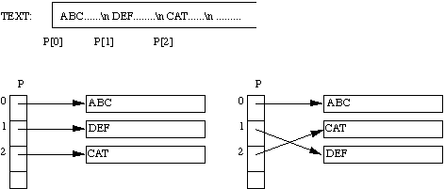
Arrays of Pointers
This eliminates:
complicated storage management.
high overheads of moving lines.

Slide 32
Arrays of Pointers (String Sorting Example)
void main(void)
{
char *p[5] = {“Rashid”, “Sajid”, “Ali”, Zahid”, “Babar” };
char * tmp; int I, j;
for( i = 0; i<5; i++)
for( j= i+1; j<4; j++ )
{ if( strcmp ( p[ i ], p[ j ]) > 0 )
{ tmp = (char * ) p[ i ] );
p[ i ] = p[ j ];
p[ j ] = tmp;
}
}
for( i = 0; i<5; i++)
puts( p[ i ] );
}

Slide 33
Pointers & 2-Dimentional Array
Example:
main()
{
int a[2][2] = { {3,4}, {5,6} };
int i, j;
for( i = 0; i<2; i++)
for( j=0; j<2; j++)
printf( “%d “, *( *( a + i ) + j ) );
getch();
}

Slide 34
Exercise
Write a C program to read through an array of any type using pointers. Write a C program to scan through this array to find a particular value.
Compare two strings for equality. If they are equal, zero is returned, otherwise the difference in value between the first two non-matching characters.

Slide 35
End of Lecture-7
Any Questions?????

